Slide 1

Banking System

Slide 2




Developed By:-
Neha Parween
Shambo Samanta
Indranil Mukherjee
Tamal Saha
Anamika Maji
Guided By
Mrs. Munmun Purkayastha

Slide 3

INTRODUCTION
Banking System
This Project describes implementation of Banking System
Banking refers to the System that allows Bank customers to access their accounts who have a valid User ID and password and do several operations along with the Accountant in order to maintain secure Banking System.

Slide 4

To Reduce Paper Work
To maintain the accounts like saving account, Current Account.
Maintaining operations like withdrawing, depositing money etc.
Providing account number to the Customer for dealing transactions in the bank.
Reducing Manual work.
Making the Software user friendly.
Providing multiple applications at a time.
Increasing security, speed, storing and accuracy.
Managing and maintaining data in an easier way.
Providing convenience to users and Accountants
Our Main Objective is to design a software which integrates all the facilities available in “Banking System”.

Slide 5

A new user can register himself/herself using the registration procedure by his/her own and will get auto generated User ID.
User can see his/her All accounts, particular account details, Transaction Details and can also Transfer money to another account or can edit his/her details
Accountant can create account for any Registered user
Accountant can see all accounts or any particular account details
Accountant can Deposit or Withdraw or Transfer from/to any account and can
See Transaction Details of any Account or
Can Edit or Delete any particular account

Slide 6

We Used to Develop the Project
Operating System:-
Windows 8 pro 🡪64 bit architecture
Other Softwares:-
Java 1.8
Eclipse Luna
Ms Word 13

Slide 7

System Requirement
Pentium 233-megahertz (MHz) processor or faster (300 MHz is Recommended).
At least 256 Megabytes (MB) of RAM (512 MB is recommended).
At least 10GigaBytes (GB) of available space on the hard disk.
Keyboard and a Microsoft Mouse or some other compatible pointing device.
Video adapter and monitor with Super VGA (800 x 600) or higher resolution

Slide 8

It can be run in different OS such as
Microsoft Windows 98, 2000,Me,XP,Vista, 7 and 8
Apple MAC OS 8,9,10 and X
Fedora Linux
Ubuntu Linux
Red Hat Linux
-and many more

Slide 9
Screen Shots

Slide 10
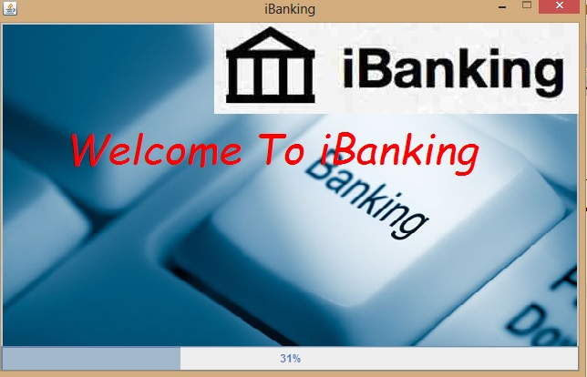

Slide 11
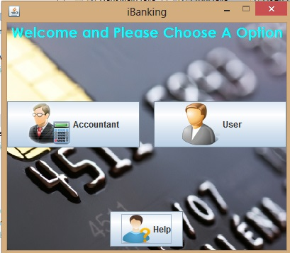

Slide 12
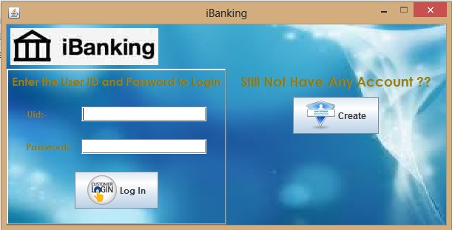

Slide 13
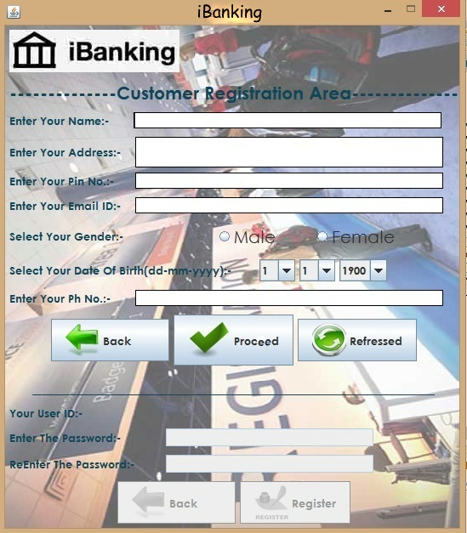

Slide 14
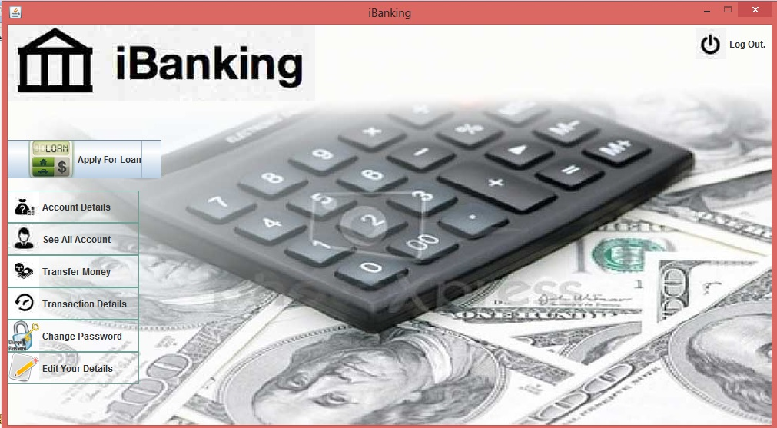

Slide 15
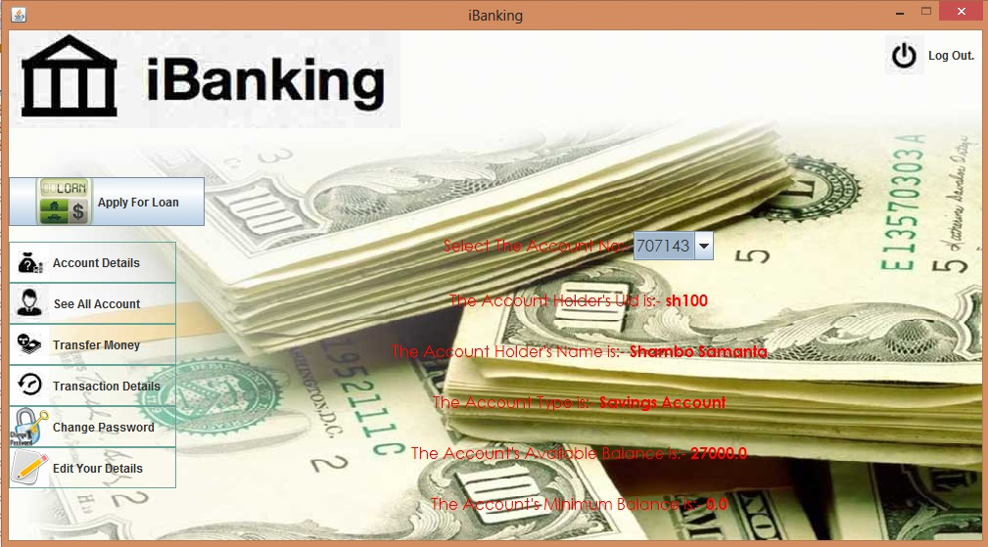

Slide 16
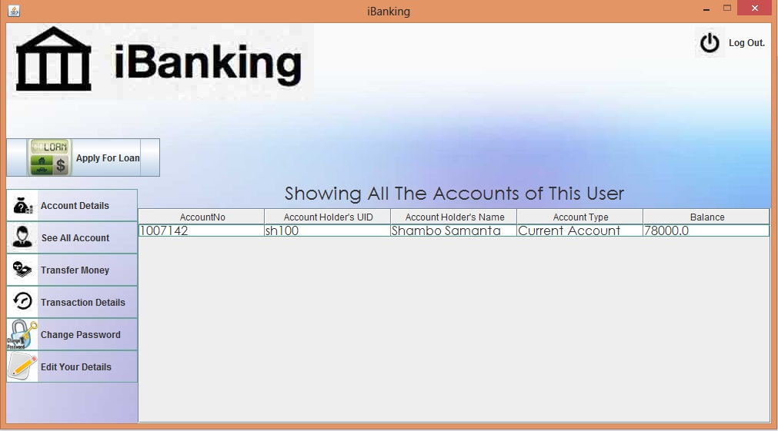

Slide 17
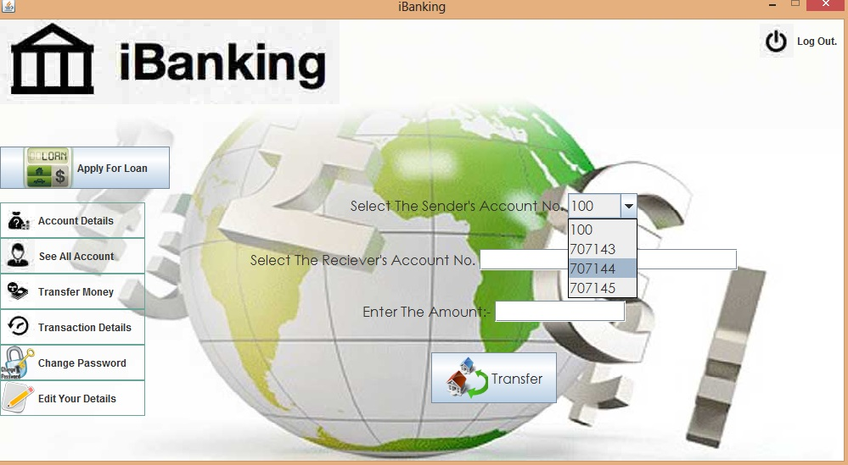

Slide 18
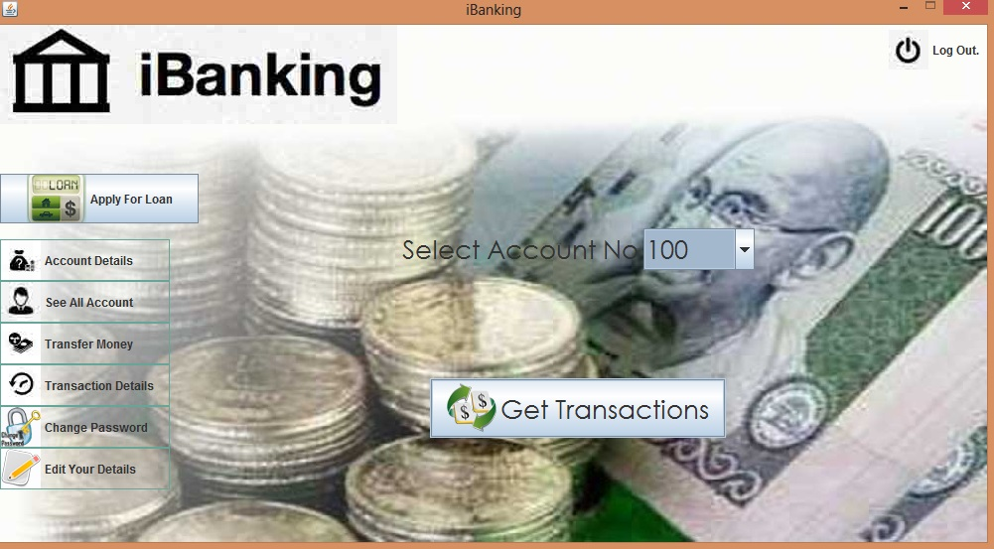

Slide 19
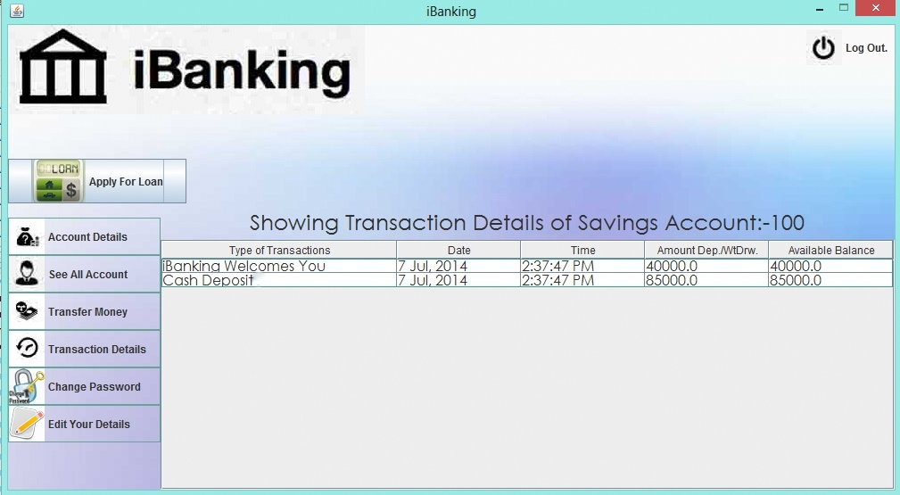

Slide 20
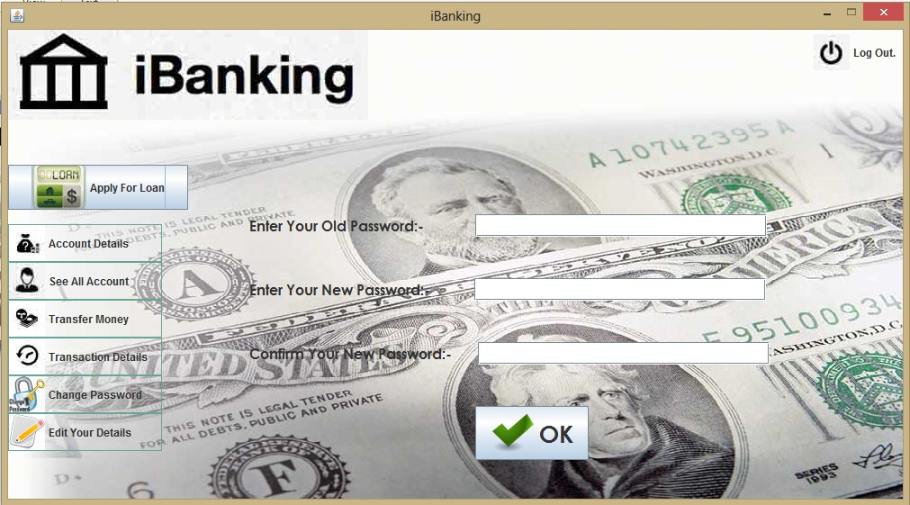

Slide 21
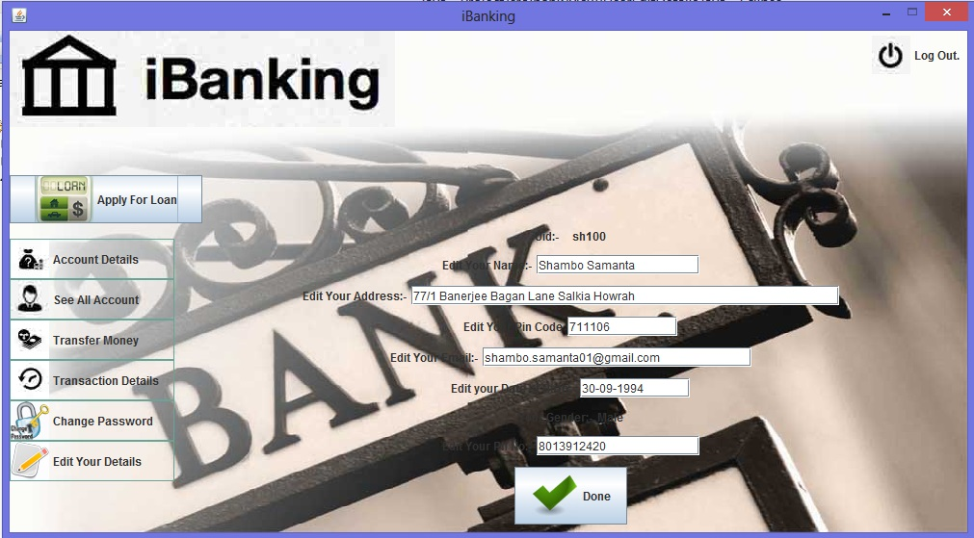

Slide 22
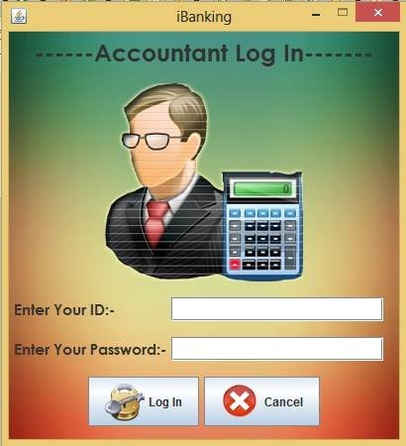

Slide 23
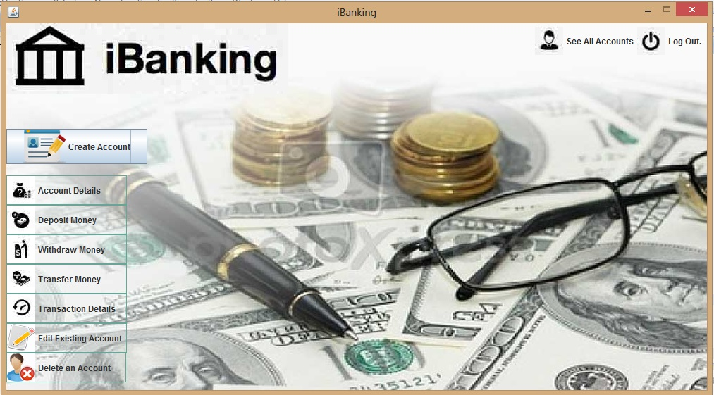

Slide 24
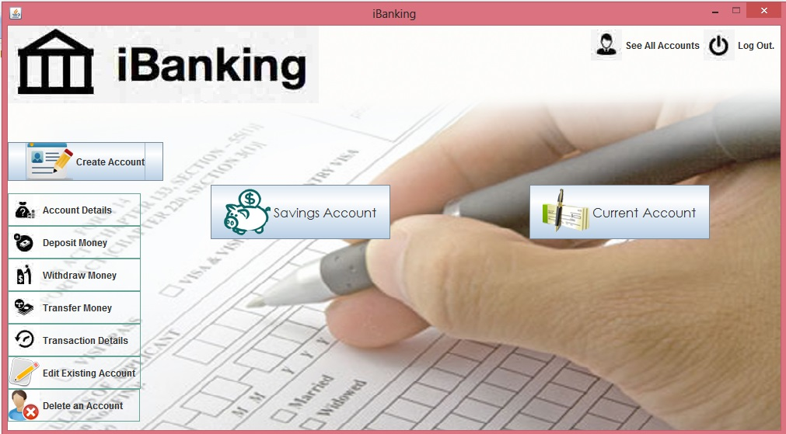

Slide 25
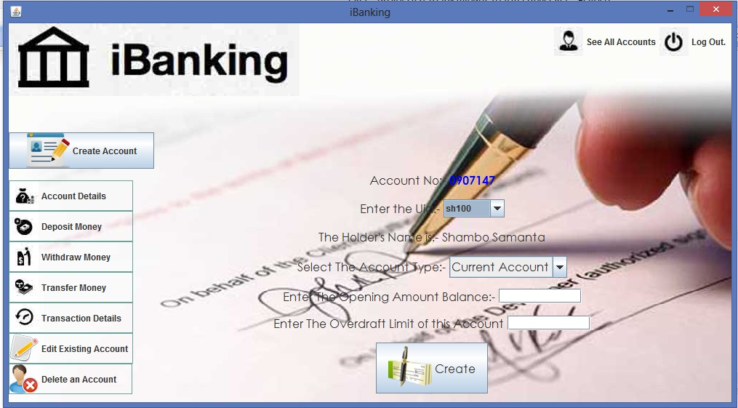

Slide 26
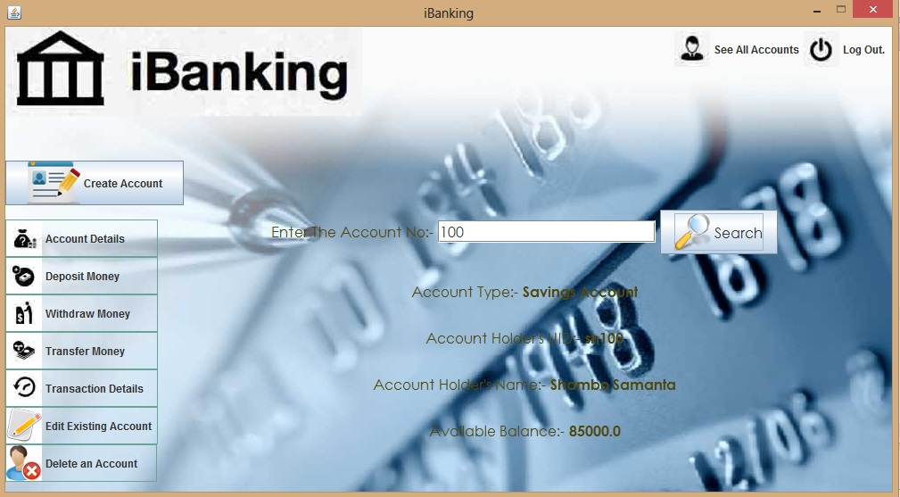

Slide 27
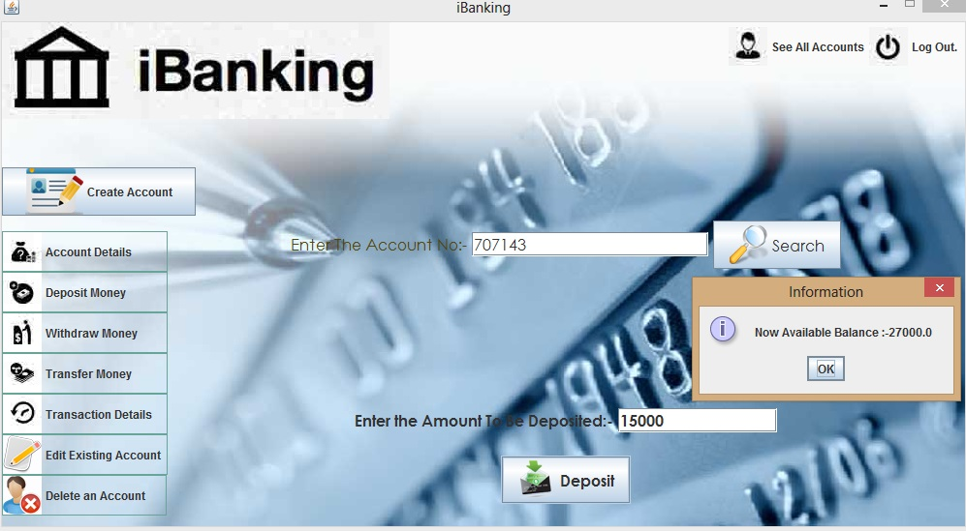

Slide 28
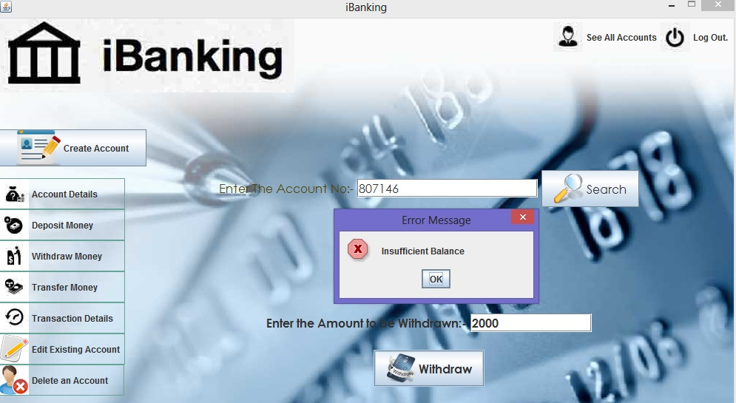

Slide 29
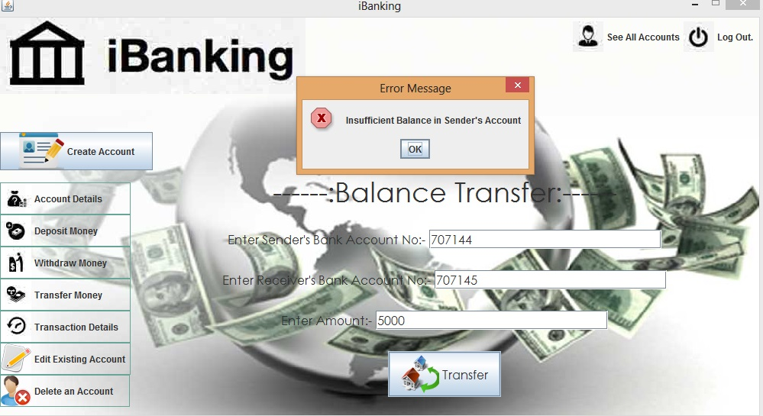

Slide 30
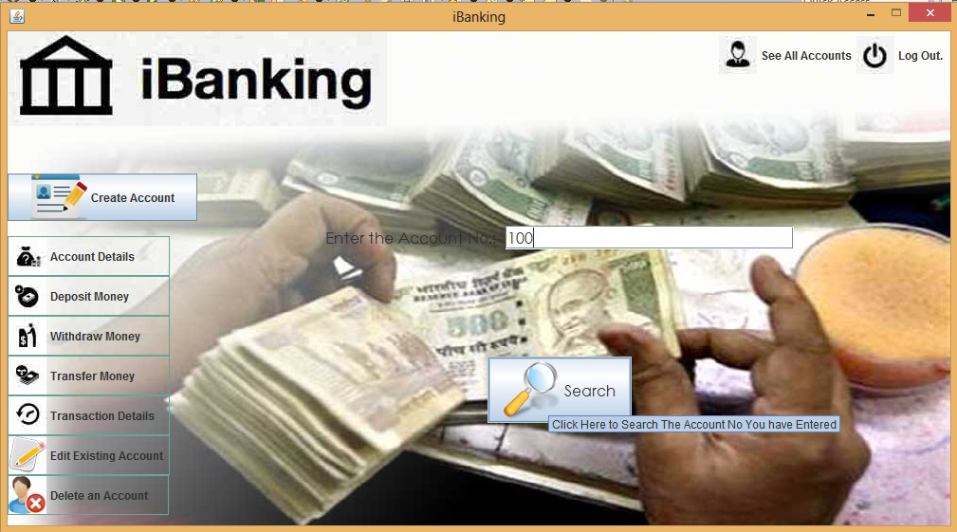

Slide 31
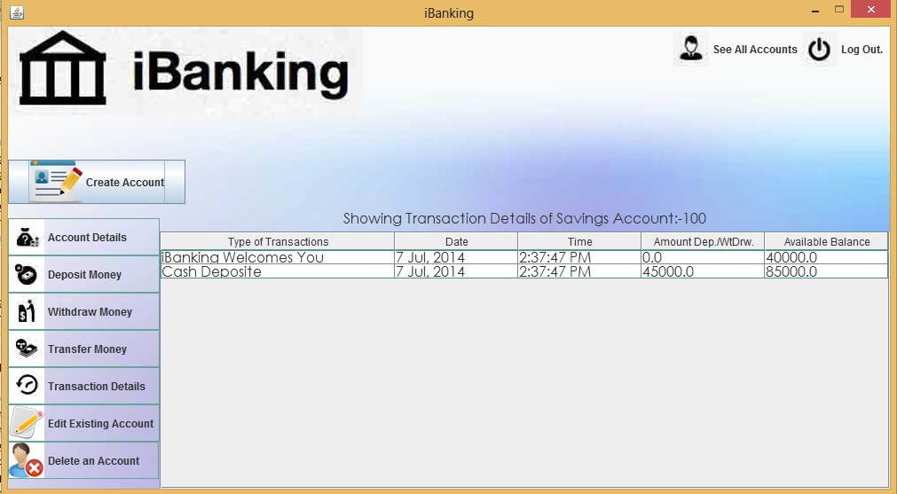

Slide 32
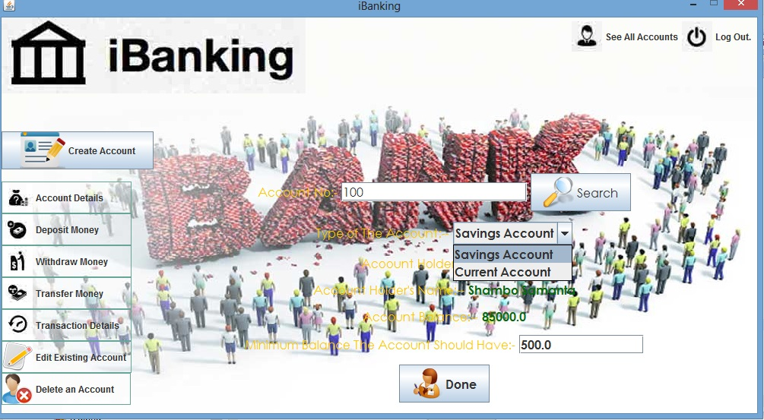

Slide 33
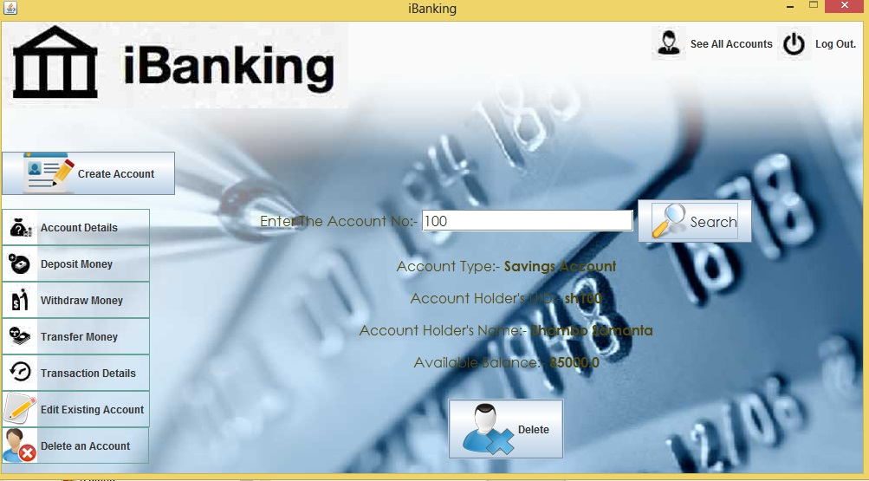

Slide 34
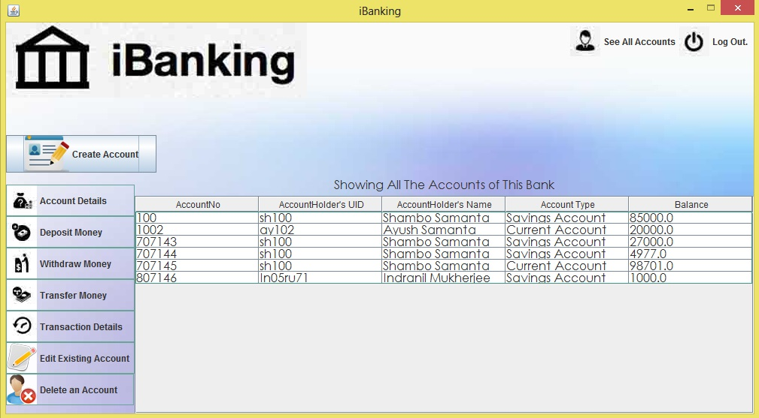

Slide 35
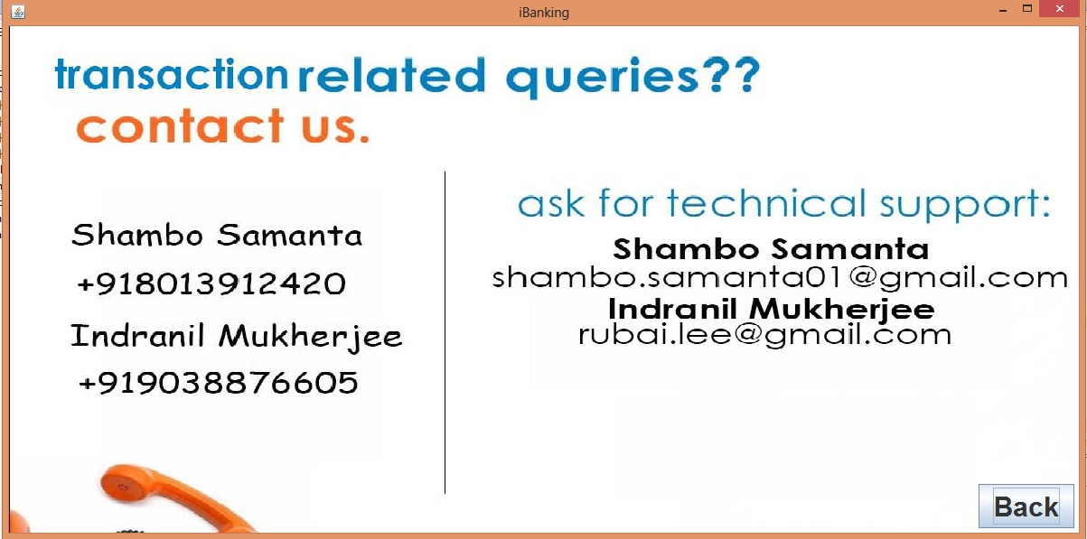

Slide 36

Drawbacks of the Project
Banking system may be mitigated by bulk loading of part data into the database.
Internet Banking is not implemented i.e. customers can’t access accounts and general info on Bank products and services through a PC or other Intelligent device.

Slide 37

It can be used by Multi-User in a Network by developing the project by J2E,servlet and JSP
We Can implement “Loan” operations to the user
We can allow the user to add his/her picture while registering for Security purpose
We can implement the print function to print the transaction details or any other info.

Slide 38

Websites:-
Google
YouTube
Book:-
Head First Java

Slide 39


Slide 40


